Slide 1
Financing Minor League Baseball (Columbus Clippers and State College Spikes)
David Dymond and Lukas Holland

Slide 2

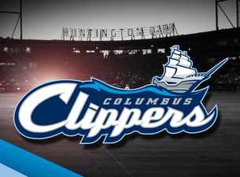
MiLB Comparison
State College Spikes
Columbus Clippers
League: New York-Penn League (Class A Short-Season) since 2006
38 game season
Affiliation: St. Louis Cardinals
League: International League West (AAA)
140 game season
Affiliation: Cleveland Indians

Slide 3
Attendance: AAA vs. Class-A

Slide 4
Ticket Prices
State College Spikes
Columbus Clippers
Outfield Bleachers: $8
Bullpen Box: $10
Field Box: $12
Diamond Club: $14
Rail Kings Deck Seats: $18
Bleacher seats: $7
Tansky Club: $10
Reserved Seats: $10
Box Seats: $13
Club Seats: $20
Loge Seats: $20

Slide 5
Stadium
Medlar Field at Lubrano Park
Huntington Park
Opened: 2005
Capacity: 5,570
Partnered with Penn State Baseball Team
Name came from past coach Charles Medlar and graduate of Penn State Anthony Lubrano, who donated $2.5 million
Opened: 2009
Capacity: 10,100
Huntington Bank paid $12 million for naming rights

Slide 6
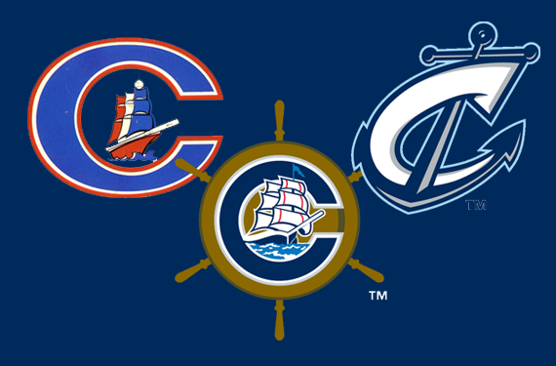
Columbus Clippers 2015
Total Revenue: $12.4 million
  Increase of $385,920 from 2014
Profit: $1.33 million
  $424,000 increase from 2014.
Total assets: $26.2 million
  Increase of $532,443 from 2014
Liabilities: $10.9 million
  Decrease of $801,727 from 2014
Net position: $15.3 million
  Increase of $1,334,170 million

Slide 7
Columbus Clippers Revenues
2014
2015
Ticket sales: $4.2 million
Concessions: $2.35 million
Souvenirs: $662,453
Parking: $182,879
Sponsorships and Advertising: $4.2 million
Special Events: $153,874
Other Revenues: $100,194
Total Operating Revenues: $11,973,470
Ticket sales: $4.4 million
Concessions: $2.36 million
Souvenirs: $863,957
Parking: $189,122
Sponsorships and Advertising: $4.2 million
Special Events: $175,225
Other Revenues: $136,357
Total Operating Revenues: $12,397,569

Slide 8
Columbus Clippers Capital Assets
2014
2015
Machinery and Equipment: $3.5 million
Leasehold Improvements: $525,453
Capital Assets: $4,063,598
Less: Accumulated Depreciation: $2.1 million
Capital Assets, net: $1,866,666
Machinery and Equipment: $3.6 million
Leasehold Improvements: $724,814
Capital Assets: $4,341,331
Less: Accumulated Depreciation: $2.5 million
Capital Assets, net: $1,775,319

Slide 9
Columbus Clippers Cash Flows (2015)
Net Cash Provided by Operating Activities
  $205,062
Net Cash Used in Capital and Relating Financing Activities:
  $419,466
Net Cash Provided by Investing Activities:
  $338,624
Cash and Cash Equivalents, Beginning of the Year: $1.212,432
Cash and Cash Equivalents, End of Year: $1.336,652

Slide 10
Columbus Clippers Operating Expenses
2014
2015
Ball Park: $5 million
Payroll and Related Taxes: $3.1 million
Team: $780,828
Souvenirs: $421,716
Advertising: $196,874
Depreciation: $333,407
Other Expenses: $579,665
Total Operating Expenses: $10,526,811
Ball Park: $5 million
Payroll and Related Taxes: $3.4 million
Team: $880,123
Souvenirs: $453,305
Advertising: $189,156
Depreciation: $369,080
Other Expenses: $627,301
Total Operating Expenses: $11,064,167

Slide 11
Future Payment Plans
Rental Payments
Lease Payments
2016: $4.1 million
2017: $4.1 million
2018: $2.1 million
2019: $2.1 million
2020: $2.1 million
2021-2025: $10.7 million
2026-2030: $10.7 million
2031-2032: $4.1 million
Total: $40,225,375
2016: $156,299
2017: $118,550
2018: $88,912
Total: $363,761
Less: Amount Representing Interest: $41,807
Present Value of Minimum Future Lease Payments: $321,954

Slide 12
Partnership Opportunities
Promotion Customization and Affordability
  Customized to meet client’s goals and budgets
Partner Satisfaction
  Conducted successful marketing campaigns
Fan Base
  Attendance of more than 42.5 million in 2015 (entire MiLB)
Close Ties to Local Communities
  Offers grassroots marketing, builds strong relationships with consumers
Reputation
  Affordable, family-friendly entertainment for people of all ages
Customer Service
  Day-to-day contact to make are all goals are met

Slide 13
Sponsors
Perks that are offered: Depends on level of sponsor.
  Suites and Season tickets
  Access to the mascots and attending events.
  Bigger partners will get holiday gifts, a holiday party, early access to ballpark. Offer batting practice when
What ROI to expect
  Some want to reach sales goals
  Some want exposure
  Some want to be seen as a community sponsor.

Slide 14
Target Market
Used to focus primarily on the baseball experience
  Fans who knew the team and followed the players
  Overlooked the condition the stadium was in
Now the primary focus is on the traditional fan
  Went from having a couple thousand attending to 5,000 to 7,000
  Put in playgrounds, bars and more dining options
  Simple attractions help to draw in more fans but
  It all comes down to the strong connection with the community

Slide 15
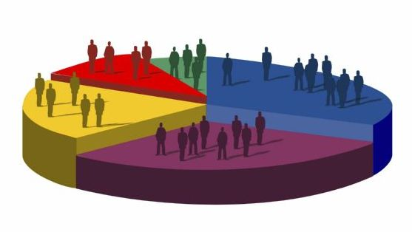
Target Market
Who is the customer?
  Families, Young professionals, mostly males
What demographics do you reach?
  Usually skews heavily male
  Highest number in the 35-44 demographic
  Families with kids
    Affordable entertainment
  Out pace the market on certain demographics (males 25-44 and 35-44)
Different promotions bring in a different target audience.

Slide 16
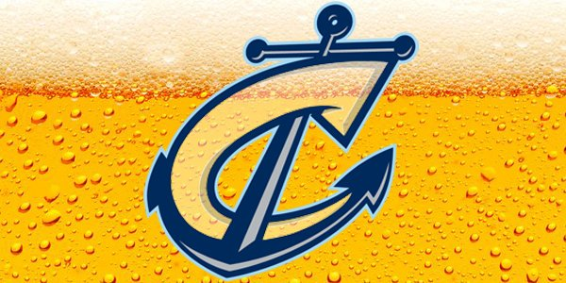
Columbus Clippers Promotions
Help to increase attendance
Examples:
  $5 Brewfest Fridays
  Guest Appearances
    Caddyshack night (Michael O’Keefe attended)
  Friday and Saturday games have live music pre-game
  Jack the Diamond Dog does tricks at four games

Slide 17
What is Your Product?
The product is sport entertainment, but mostly focused on entertainment. People come not only for the game, but also for the bars and restaurants, the sponsored and non sponsored events, and the games and giveaways

Slide 18
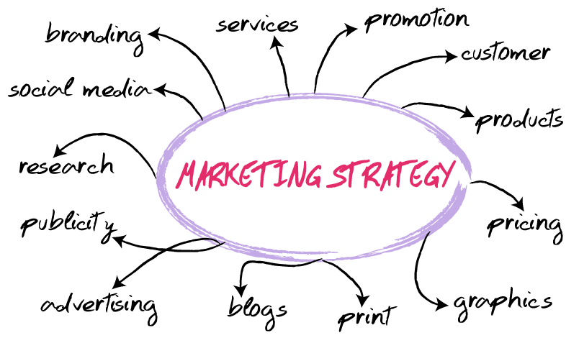
Marketing Strategies
Games
  Advertisement through partners and sponsors through their stores and businesses. They partner with the Blue Jackets and the take turns doing things in each others places.
Developed yearly: marketing strategies are changed and adapted to keep up with the times and advancements in technology

Slide 19


Marketing Efforts
Social and Print Media are used about the same amount.
  Social media: email blasts, retargeting
  Print media used to advertise: Games
  Social media used to advertise: Events, merchandise
    “Cyber Monday”
Socialization
  The organizations depend on people going in groups to games
    Professionals, families, friends

Slide 20
5 Year Plan
Marketing
Finances
  Continue what the Clippers are doing. There profits are increasing as depreciation and costs are.
Operating
  Area of improvement here is to run more special events in the off-season. Events such as concerts, comedians and anything else that may be of interest in Columbus. Opening the stadium to more than just baseball will help to increase revenue and profit.

Slide 21
References
MiLB. (2016). Null Attendance | MiLB.com Stats | The Official Site of Minor League Baseball. Retrieved November 03, 2016, from http://www.milb.com/milb/stats/stats.jsp?t=l_att
MiLB. (2016). The Official Site of The Columbus Clippers | clippersbaseball.com Homepage. Retrieved November 03, 2016, from http://www.milb.com/index.jsp?sid=t445
MiLB. (2016). The Official Site of The State College Spikes | statecollegespikes.com Homepage. Retrieved November 03, 2016, from http://www.milb.com/index.jsp?sid=t1174
Hill, J. (2016, July 6). Once bought for $25,000, the Columbus Clippers have become a $25 million asset for Franklin County. Retrieved November 03, 2016, from http://www.bizjournals.com/columbus/news/2016/07/06/once- bought-for-25-000-the-columbus-clippers-have.html

Slide 22
State College Spikes. (2015, September 2). Ballpark History. Retrieved November 04, 2016, from http://www.milb.com/content/page.jsp?ymd=20090312&conte nt_id=40996002&sid=t1174&vkey=team1
MiLB. (2015, September 2). Partnership Opportunities | MiLB.com Official Info | The Official Site of Minor League Baseball. Retrieved November 04, 2016, from http://www.milb.com/milb/info/partnership.jsp
Bona, C. M. (2016). Columbus Clippers: 2016 guide to promotions, food, beer, more (photos). Retrieved November 04, 2016, from http://www.cleveland.com/entertainment/index.ssf/2016/04/col umbus_clippers_2016_guide_t.html

